Slide 1
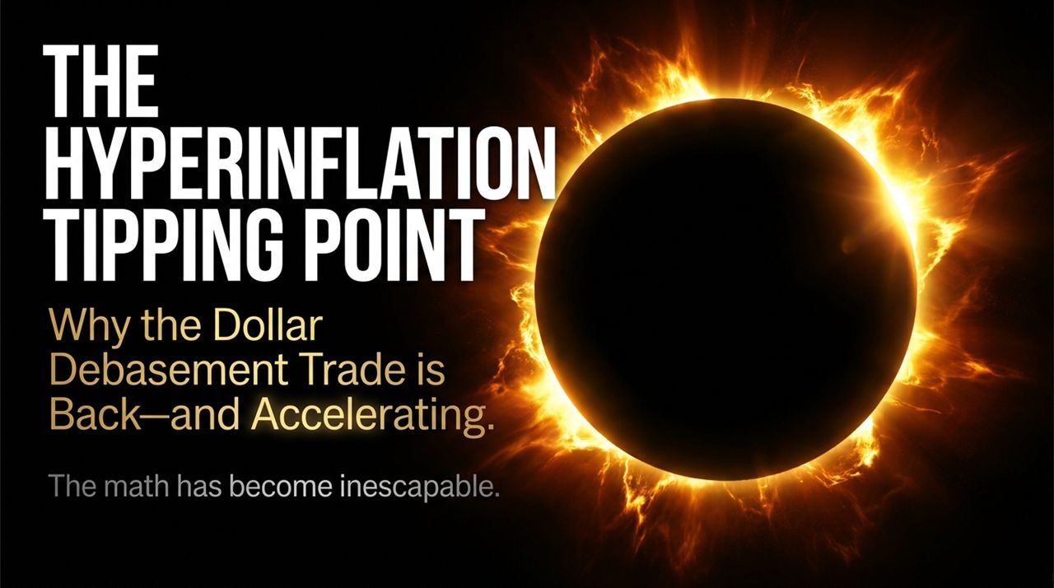
Notes:
Introduction & Hook:
"Good day, everyone. Today, we are addressing what I consider to be the single most critical macroeconomic transition of our generation: The Dollar Debasement Trade and why it has reached a mathematical point of no return. For years, mainstream media and traditional economists treated discussions around hyperinflation or sovereign default as fringe theory. Today, we are going to look at the cold, hard balance sheet of the United States government and demonstrate why the math has become inescapable."
Core Narrative & Thesis:
"The title of today’s briefing is 'The Hyperinflation Tipping Point'. We are not talking about standard cyclical inflation caused by short-term supply chain snarls. We are talking about structural monetary debasement driven by federal debt dynamics. When a sovereign state accumulates debt at a rate faster than its real economy can grow, and when interest payments alone consume the budget, traditional monetary policy ceases to function. That is where we are today."
Transition:
Here are comprehensive, professional speaker notes tailored for Slides 1 through 13 of "The Hyperinflation Tipping Point" presentation deck. Each slide's script is formatted with distinct sections for key takeaways, delivery cues, and targeted talking points calibrated for a 2 to 6-minute presentation per slide.
PDF+ 1
Slide 1: Title Slide — The Hyperinflation Tipping Point
Target Duration: 2 – 3 Minutes
Slide Visual: Cover page titled "THE HYPERINFLATION TIPPING POINT: Why the Dollar Debasement Trade is Back—and Accelerating" with the subtitle "The math has become inescapable."
PDF
Speaker Script / Notes:
Introduction & Hook:
"Good day, everyone. Today, we are addressing what I consider to be the single most critical macroeconomic transition of our generation: The Dollar Debasement Trade and why it has reached a mathematical point of no return. For years, mainstream media and traditional economists treated discussions around hyperinflation or sovereign default as fringe theory. Today, we are going to look at the cold, hard balance sheet of the United States government and demonstrate why the math has become inescapable."
PDF+ 1
Core Narrative & Thesis:
"The title of today’s briefing is 'The Hyperinflation Tipping Point'. We are not talking about standard cyclical inflation caused by short-term supply chain snarls. We are talking about structural monetary debasement driven by federal debt dynamics. When a sovereign state accumulates debt at a rate faster than its real economy can grow, and when interest payments alone consume the budget, traditional monetary policy ceases to function. That is where we are today."
PDF+ 3
Transition:
"Over the next 12 slides, we will break down the exact mechanism of this trap—how traditional Federal Reserve policy breaks down, how AI accelerates the deficit, and why physical assets, gold, and Bitcoin are the only logical exit ramps. Let's turn to Slide 2 to see why traditional economic models no longer work."
Luke Gromen: This Is How Hyperinflation Begins
https://www.youtube.com/watch?v=9dUte6c7ZcM

Slide 2
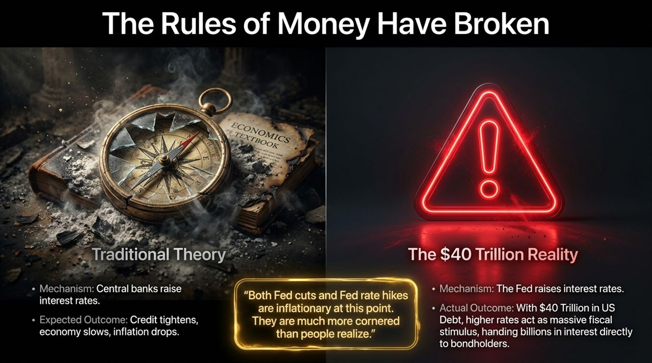
Notes:
Contextualizing the Shift:
"Look at the visual on the left—a broken compass resting on a burnt economics textbook. That is the reality facing market participants today. For four decades, money managers were taught a simple rulebook: when inflation rises, central banks raise interest rates. Higher rates tighten credit, slow corporate borrowing, lower economic demand, and ultimately bring inflation down. That model works when national debt is low to moderate."
Deconstructing the $40 Trillion Reality:
"Now look at the right side of the slide: The $40 Trillion Reality. When U.S. sovereign debt hits $40 Trillion, raising interest rates creates a paradox. Every 100 basis points of Fed hikes adds hundreds of billions of dollars directly to federal interest expenditure. Where does that interest money go? It goes directly into the private economy—handed straight to treasury bondholders, money market funds, and global institutions as liquid cash income.
Instead of tightening liquidity, rate hikes become a massive fiscal stimulus. As the quote on the slide highlights: 'Both Fed cuts and Fed rate hikes are inflationary at this point. They are much more cornered than people realize.' If they cut rates, they debase the currency; if they raise rates, they explode the fiscal interest deficit. The central bank is boxed in."
Takeaway for Investors:
"If rate hikes no longer extinguish inflation, then traditional financial assets like long-duration paper bonds lose their primary defense mechanism. The compass is broken, and we must navigate using a new framework."

Slide 3
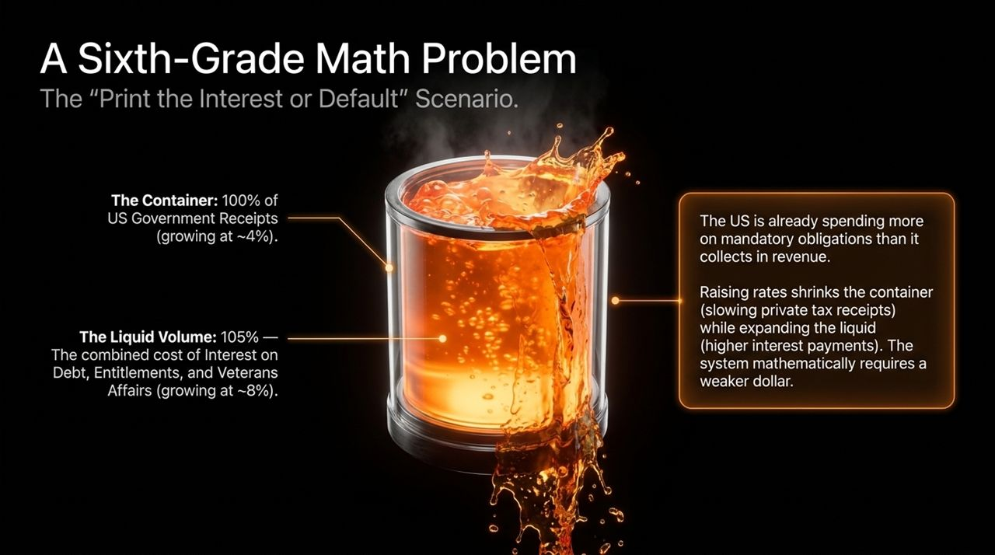
Notes:
Setting Up the Analogy:
"To understand why this is an inevitable tipping point, you don't need a Ph.D. in econometrics. You need sixth-grade arithmetic. On this slide, we use a simple fluid container visual.
The container represents 100% of U.S. government tax receipts, which grow at a historical nominal baseline of roughly 4% per year. The liquid inside represents the U.S. government's mandatory obligations—namely Interest on Debt, Entitlements (Social Security and Medicare), and Veterans Affairs—which grow at roughly 8% annually."
The Core Mathematical Imbalance:
"Notice the liquid level: 105%. Before the U.S. government spends a single dollar on national defense, roads, education, border security, or federal agencies, 105% of all tax revenues are already spoken for by mandatory spending and debt service.
Every single dollar of non-mandatory discretionary spending is funded 100% by freshly issued debt. Now, consider what happens when the Fed raises interest rates to curb inflation:
Higher interest rates slow the private economy, which shrinks the container (reducing tax receipts).
Simultaneously, higher interest rates raise national interest expenses, which expands the volume of the liquid.
The beaker overflows violently. The government faces two choices: explicitly default on bondholders or print the interest to inflate the debt away. History tells us sovereigns always print."
Wrap-Up:
"This is why U.S. debt cannot be 'paid back' in standard purchasing power. The system mathematically requires a weaker dollar."

Slide 4
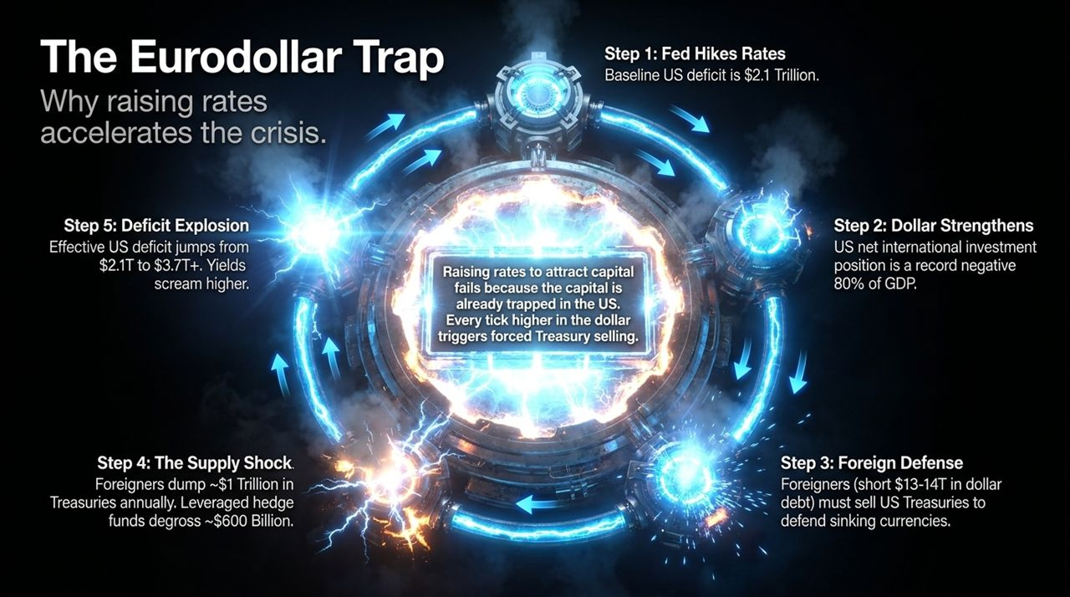
Notes:
Overview of the Global Feedback Loop:
"Why can’t the U.S. just attract foreign capital by keeping interest rates elevated? This slide maps out The Eurodollar Trap—the vicious self-reinforcing engine driving yield spikes.
Let's walk through the five-step loop on the chart:
Step 1: The Fed hikes rates to defend against inflation. The U.S. starts with a baseline fiscal deficit of $2.1 Trillion.
Step 2: The U.S. Dollar strengthens globally. However, the U.S. Net International Investment Position is at a record negative 80% of GDP."
The Foreign Liquidation Engine:
"* Step 3: Foreign Defense. Foreign central banks and corporations hold roughly $13 Trillion to $14 Trillion in dollar-denominated debt. As the dollar surges, local currencies collapse against the dollar. To defend their currencies and service dollar obligations, foreign governments must sell U.S. Treasuries to raise dollar cash.
Step 4: The Supply Shock. Foreigners liquidate approximately $1 Trillion in U.S. Treasuries annually. At the same time, leveraged hedge funds conducting the treasury basis trade are forced to degross roughly $600 Billion.
Step 5: Deficit Explosion. This forced selling drives treasury yields sharply higher. Higher yields push the effective U.S. deficit from $2.1 Trillion to $3.7 Trillion+."
Key Summary:
"Notice the text in the center: 'Raising rates to attract capital fails because the capital is already trapped in the U.S. Every tick higher in the dollar triggers forced Treasury selling.' The tighter the Fed tries to squeeze the system, the faster the foreign liquidation of U.S. debt accelerates."

Slide 5

Notes:
Historical Empirical Data:
"When analyzing macroeconomic regimes, investors often say 'this time is different.' Let's examine the empirical data spanning the last 220 years.
Since the year 1800, exactly 53 countries have reached a sovereign Debt-to-GDP ratio of 130% or higher. Out of those 53 nations, 52 experienced an explicit sovereign default or hyperinflationary restructuring. That is a 98.1% historical failure rate."
The 53rd Sovereign: Japan:
"Who is the 53rd country? Japan. And Japan is actively demonstrating what happens at the end-stage. The Bank of Japan is forced to cap yields while its currency drops, actively inflating away its sovereign debt obligations while its bond market experiences severe distress.
In the world of macro investing, finding trade setups with a 100% historical probability is almost impossible. This is as close to a 100% historical guarantee as macro financial history provides. The U.S. has crossed into this exact debt threshold."
Takeaway:
"Countries do not pay back debt levels above 130% of GDP with purchasing power; they inflate the debt into irrelevance. The debasement trade isn't a speculative play—it is a mathematical necessity."

Slide 6
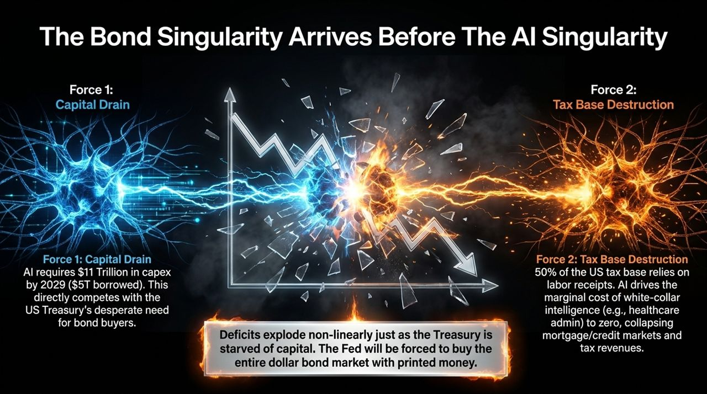
Notes:
Introducing the AI Conflict:
"Many market analysts believe that Artificial Intelligence will generate a productivity boom large enough to outgrow U.S. national debt. This slide illustrates why AI actually accelerates the sovereign bond crisis. We call this the Bond Singularity arriving before the AI Singularity."
Force 1: Capital Drain:
"Look at Force 1: Capital Drain. Building out global AI infrastructure requires an estimated $11 Trillion in capital expenditure by 2029, with at least $5 Trillion funded through debt markets. Big Tech, private equity, and utilities are borrowing aggressively.
This private sector capex boom competes directly with the U.S. Treasury for capital. When corporate bond issuers offer high yields backed by real AI cash flows, who wants to hold low-yielding U.S. Treasuries? Private capital drains away from government debt."
Force 2: Tax Base Destruction:
"Now look at Force 2: Tax Base Destruction. Roughly 50% of U.S. federal tax revenue relies directly on personal labor receipts (payroll and income taxes).
AI drives the marginal cost of white-collar intelligence and administrative tasks toward zero. As high-paying professional labor is automated or displaced, personal income tax collections drop, disrupting mortgage and consumer credit markets. Deficits explode non-linearly at the exact moment the Treasury is starved of bond buyers."
Conclusion of Slide:
"The Fed will eventually be forced to become the buyer of last resort for the entire Treasury market, printing money to absorb the supply."

Slide 7

Notes:
Defining Hyperinflationary Mindset:
"Hyperinflation is not merely a monetary phenomenon—it is a psychological tipping point. It begins the moment economic actors lose faith in the future purchasing power of currency and prefer holding physical goods over fiat money."
Industrial Supply Chain Signals:
"Examine the statement from U.S. industrial executives in 2024 on the slide: 'I would rather have copper in my warehouse than cash in my bank.'
Why are supply chain leaders saying this? Because global supply chains are fracturing, and lead times for critical industrial components have stretched to 12 to 18 months. Paper wealth is useless if cash cannot purchase scarce physical inventory when needed. When corporate treasurers actively convert bank deposits into raw commodity stockpiles, the hyperinflationary mindset has already taken hold."
Strategic Insight:
"When the real economy shifts from financialized assets back to physical inventories, money velocity surges, accelerating the currency's decline."

Slide 8
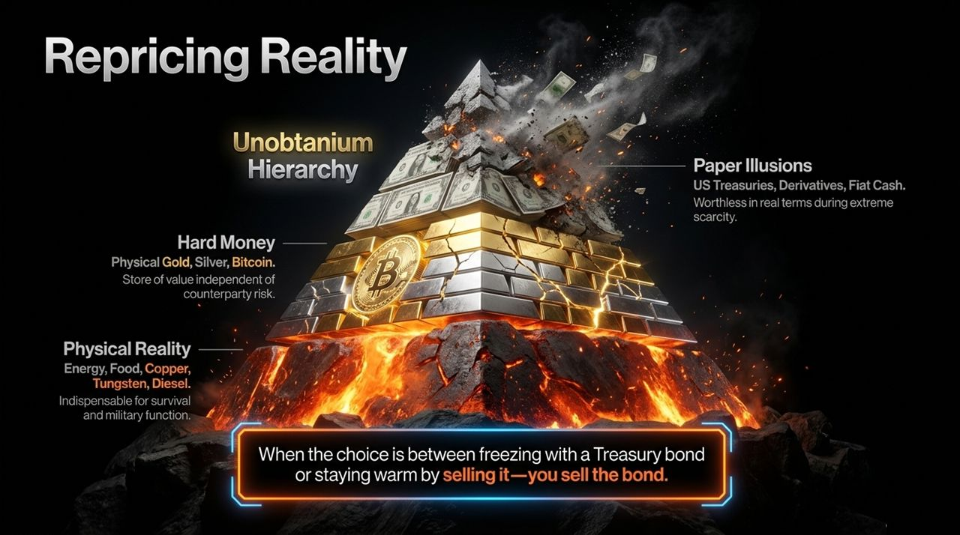
Notes:
Walking Through the Hierarchy Pyramid:
"As paper wealth loses credibility, global markets reorder assets based on counterparty risk and physical utility. This slide outlines The Unobtanium Hierarchy.
Tier 1: Hard Money (Top). Physical Gold, Silver, and Bitcoin. These represent bearer assets with zero counterparty risk and absolute mathematical scarcity.
Tier 2: Physical Reality (Middle). Energy, Food, Copper, Tungsten, and Diesel. These are essential inputs required for industrial society, military function, and basic human survival."
The Failure of Paper Illusions:
"* Tier 3: Paper Illusions (Bottom). U.S. Treasuries, unbacked bank deposits, financial derivatives, and fiat cash. In times of extreme resource scarcity, these paper contracts lose real purchasing power.
Note the summary statement at the bottom of the slide: 'When the choice is between freezing with a Treasury bond or staying warm by selling it—you sell the bond.' Institutional capital is shifting up the pyramid, liquidating paper promises to secure real-world physical assets."
Closing Point:
"Understanding this hierarchy is vital for portfolio construction in a debasement regime."

Slide 9
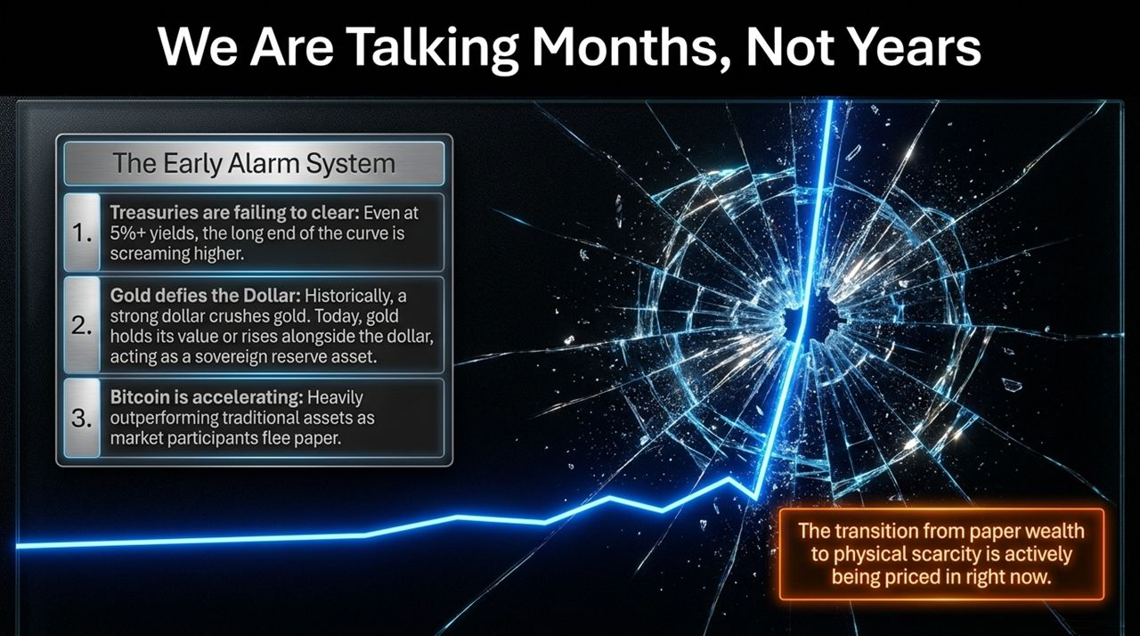
Notes:
Timeline Shift:
"Many institutional investors believe they have years to adjust to this dynamic. However, market indicators show that this repricing is taking place right now."
Breaking Down the 3 Warning Indicators:
"Let's review the 3 Early Alarm Signals highlighted on the screen:
Treasuries Failing to Clear: Even with yields above 5%, long-end Treasury auctions are exhibiting structural weakness, pushing yields higher.
Gold Defying the Dollar: Historically, a rising U.S. Dollar Index crushed gold prices. Today, gold is making all-time highs alongside a strong dollar, signaling its role as a neutral sovereign reserve asset.
Bitcoin Accelerating: Bitcoin continues to outperform traditional paper assets, functioning as an alarm system for monetary debasement."
Takeaway:
"The market transition from paper wealth to physical scarcity is actively being priced in. Capital allocation decisions must reflect current market dynamics, not past cycles."

Slide 10
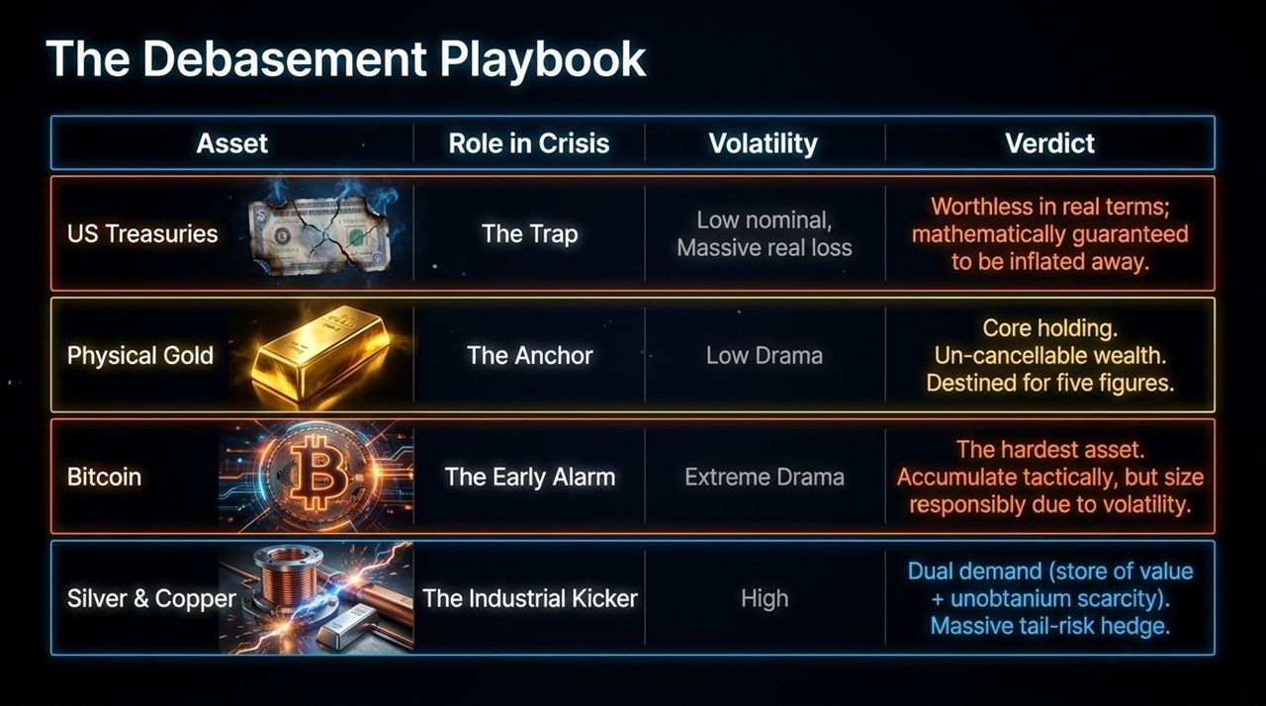
Notes:
Evaluating Asset Classes:
"How do we translate this macroeconomic diagnosis into an actionable investment allocation? This slide presents The Debasement Playbook across four key asset categories:
U.S. Treasuries (The Trap): Volatility is low nominal, but real purchasing power losses are guaranteed as the debt is inflated away. Verdict: Worthless in real terms."
Hard Assets & Industrial Commodities:
"* Physical Gold (The Anchor): Low drama, un-cancellable wealth independent of sovereign defaults. Verdict: Core foundational holding.
Bitcoin (The Early Alarm): High volatility, extreme upside potential as the hardest digital monetary asset. Verdict: Accumulate tactically, sizing appropriately for volatility.
Silver & Copper (The Industrial Kicker): High volatility with dual demand drivers—functioning as both monetary stores of value and indispensable industrial materials. Verdict: Massive tail-risk hedge."
Portfolio Strategy:
"By reallocating away from paper traps into physical anchors, investors can protect purchasing power during monetary debasement."

Slide 11
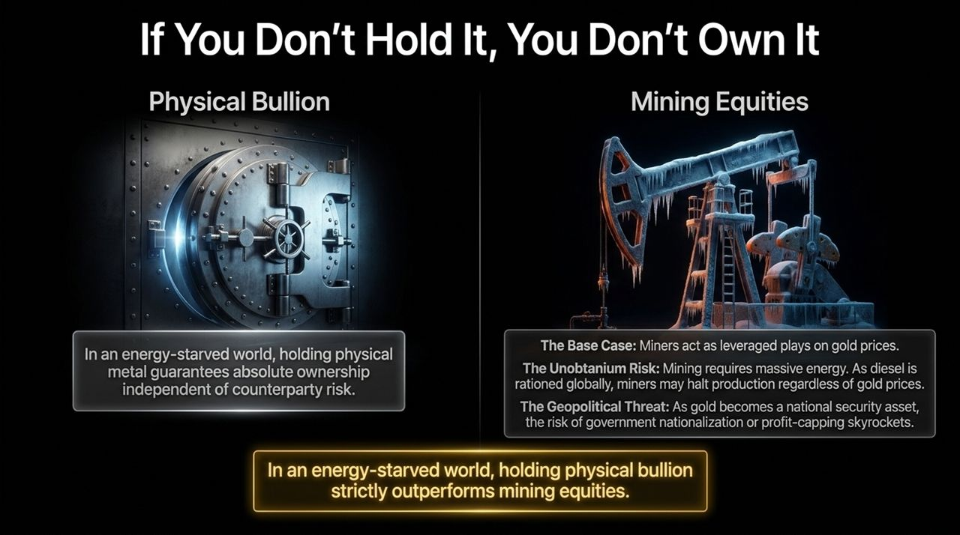
Notes:
Physical Bullion vs. Mining Equities:
"A common question from investors is: 'Why not just buy gold mining stocks instead of physical bullion to get operational leverage?' Slide 11 breaks down why physical bullion outperforms equities in an end-stage debasement scenario."
Analyzing Operational and Geopolitical Risks:
"While mining equities traditionally act as leveraged plays on gold, they face two structural threats in a resource-scarce regime:
The Unobtanium Risk: Mining requires significant energy inputs, particularly diesel and grid power. If global diesel is rationed or power grids destabilize, miners may be forced to halt operations regardless of how high gold prices go.
Geopolitical & Nationalization Threats: As gold becomes recognized as a critical national security asset, governments face incentives to nationalize mines, impose windfall taxes, or cap realized profits."
Core Lesson:
"Holding physical bullion unencumbered by counterparty or operational risk remains a key structural distinction. If you don't hold it, you don't own it."

Slide 12
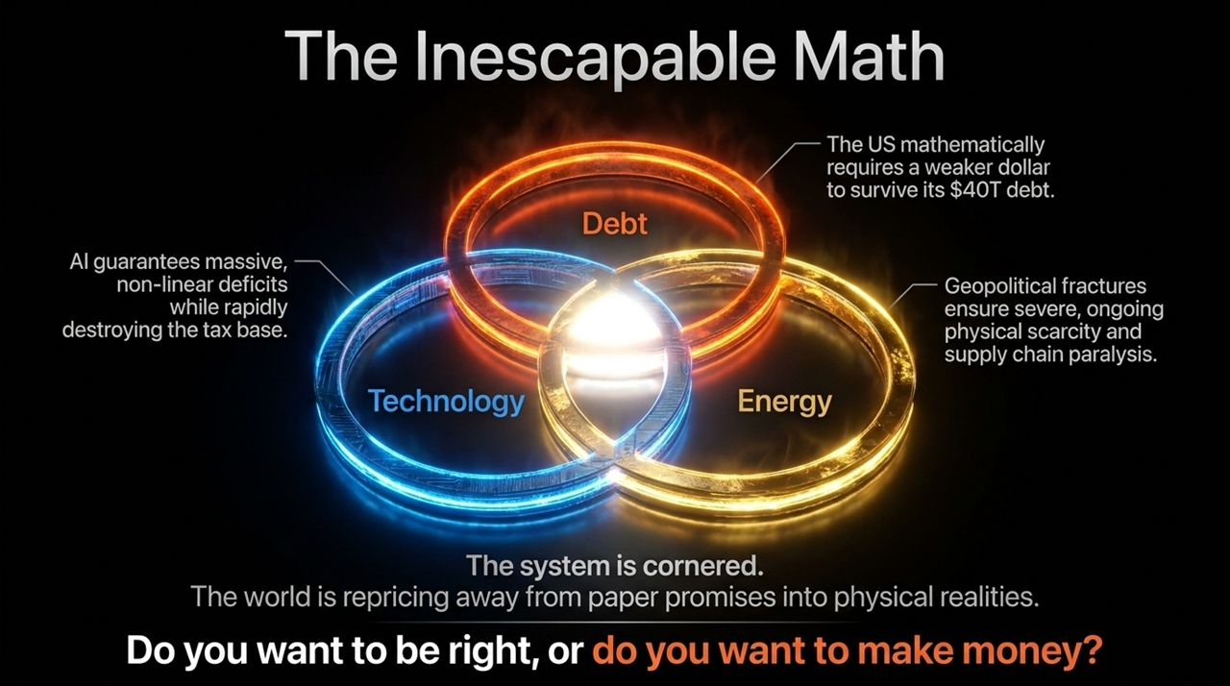
Notes:
Synthesizing the Core Macro Drivers:
"This slide brings our analysis together into a single unified framework represented by three intersecting rings: Debt, Technology, and Energy.
Debt: U.S. debt at $40 Trillion mathematically forces currency debasement to avoid explicit default.
Technology: AI accelerates structural deficits by competing for capital while displacing the labor-based tax base.
Energy & Geopolitics: Fracturing supply chains and energy constraints drive persistent real-world physical scarcity."
Addressing the Final Question:
"When these three forces converge, paper financial assets face structural pressure while physical assets reprice higher.
Look at the final question on the screen: 'Do you want to be right, or do you want to make money?' Being 'right' according to traditional economic textbooks will not protect capital when those rules no longer apply. Adapting to these mathematical realities is necessary to preserve wealth."

Slide 13
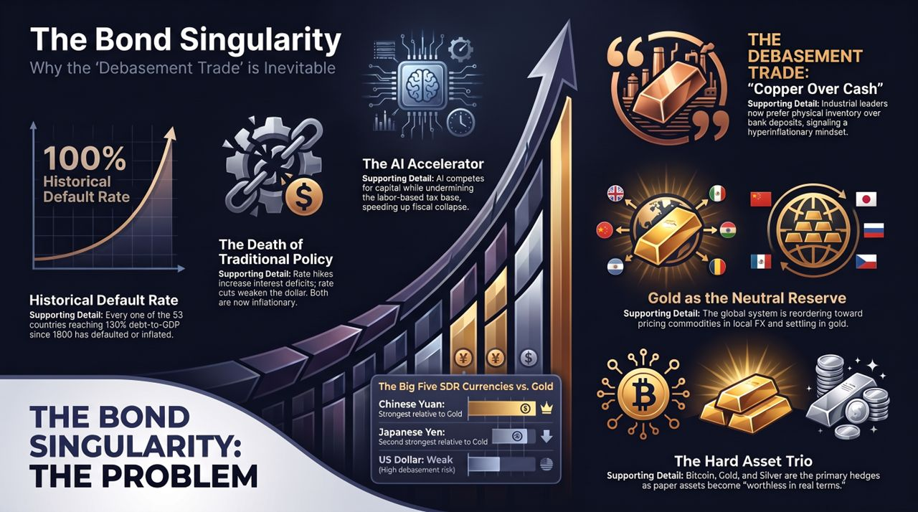
Notes:
Executive Summary of the Problem:
"To conclude our presentation, Slide 13 provides an executive briefing summary. On the left, we have The Bond Singularity (The Problem):
100% Historical Default Rate: Every country hitting 130% Debt-to-GDP since 1800 has restructured or inflated away its obligations.
The Death of Traditional Policy: Both rate cuts and rate hikes are now expansionary and inflationary.
The AI Accelerator: AI capital expenditures starve the Treasury of buyers while eroding the labor tax base."
Executive Summary of the Solution:
"On the right, we have The Debasement Trade (The Solution):
'Copper Over Cash': Industrial leaders prefer physical inventory over depreciating bank deposits.
Gold as the Neutral Reserve Asset: Global trade settlement is reordering toward local currencies backed by physical gold.
The Hard Asset Trio: Bitcoin, Gold, and Silver serve as primary hedges against paper debasement."
Final Closing Statement:
"The mathematical transition is underway. By positioning capital out of paper liabilities and into scarce, physical, and un-cancellable assets, investors can navigate this macroeconomic shift. Thank you, and I am now open to your questions."
For additional video context and discussion on dollar debasement trends, see Luke Gromen's analysis on hyperinflation, which details these exact macro drivers.
Luke Gromen: This Is How Hyperinflation Begins
https://www.youtube.com/watch?v=9dUte6c7ZcM

